Slide 1
Iconic Saga Retreat
2023
Kent

Slide 2


Chapters
Cam Newton YouTube Where we came from, where we are, where we are going
Funky Friday YouTube
Future Content idea
Iconic Saga YouTube Biz What are we doing now, What else can we do?
Brainstorm

Slide 3
Analytics TOTAL
731,000 subscribers
83,000,000 total views
700,000,000 total impressions
574 Total uploads
4.9% click through rate
$175,000 total revenue

Slide 4
06.2022
06.2023
Analytics Monthly
Analytics Monthly
2,276 subscribers
267,000 views
115,303 43% Shorts
152,155 57% Videos
5,400,000 impressions
20 Total uploads
16 shorts
4 Videos
3.2% click through rate
$1,300 total revenue (est.)
26,200 subscribers
7,100,000 views
6.4M 90% Shorts
657,000 9.2% Videos
6,000 0.1% live
20,700,000 impressions
29 Total uploads
20 Shorts
8 videos
1 live
5.6% click through rate
$6,911 total revenue

Slide 5
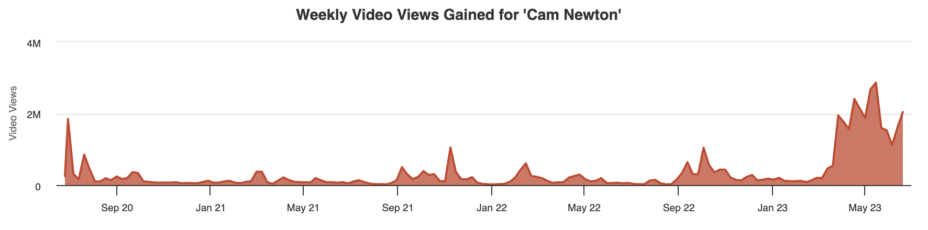
CN YouTube Analytics

Slide 6
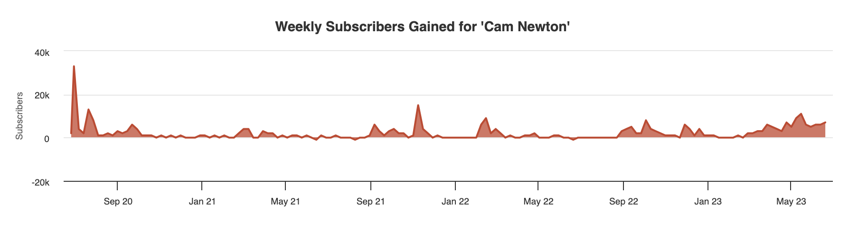
CN YouTube Analytics

Slide 7
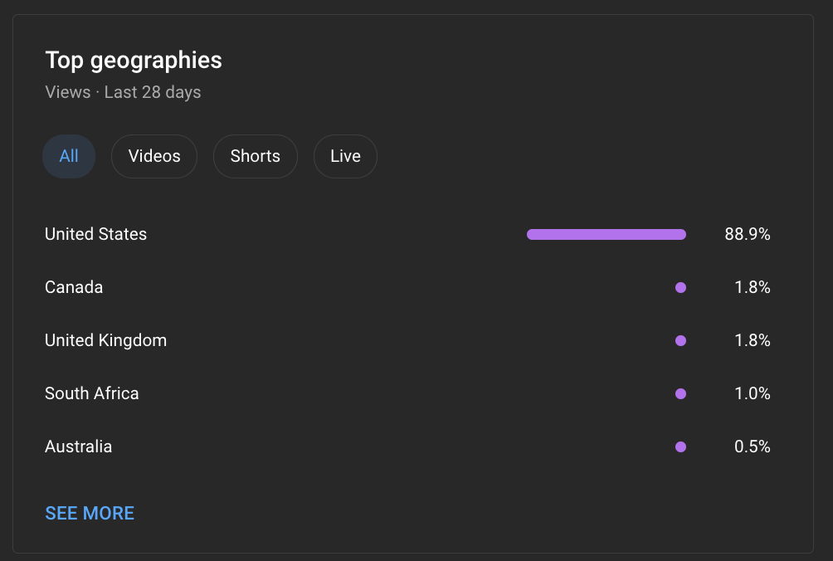
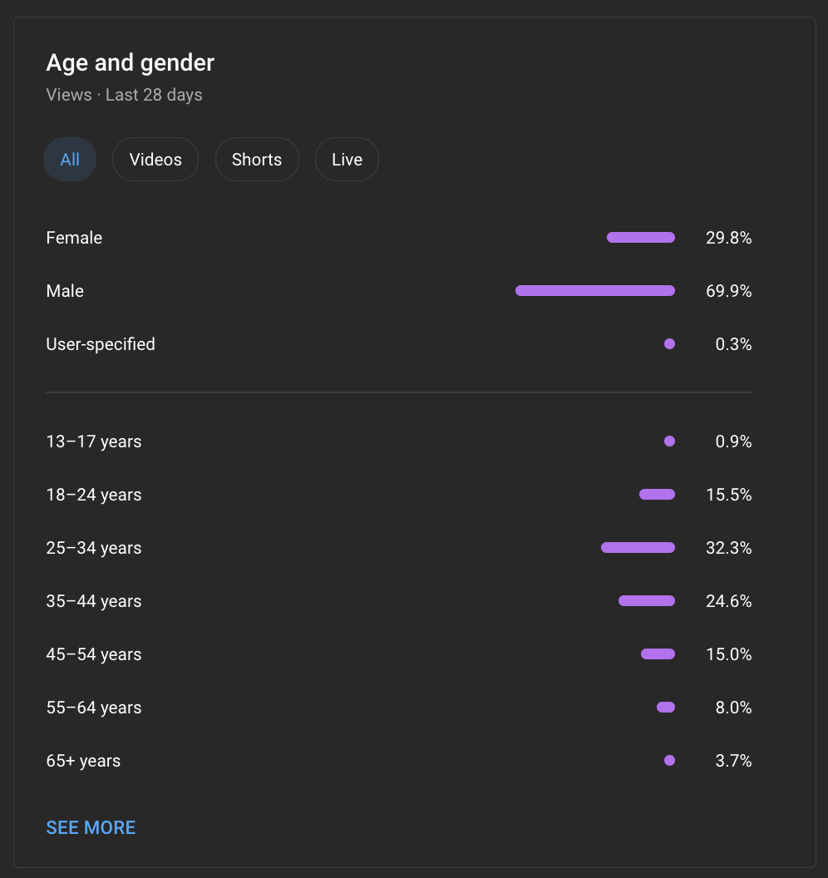
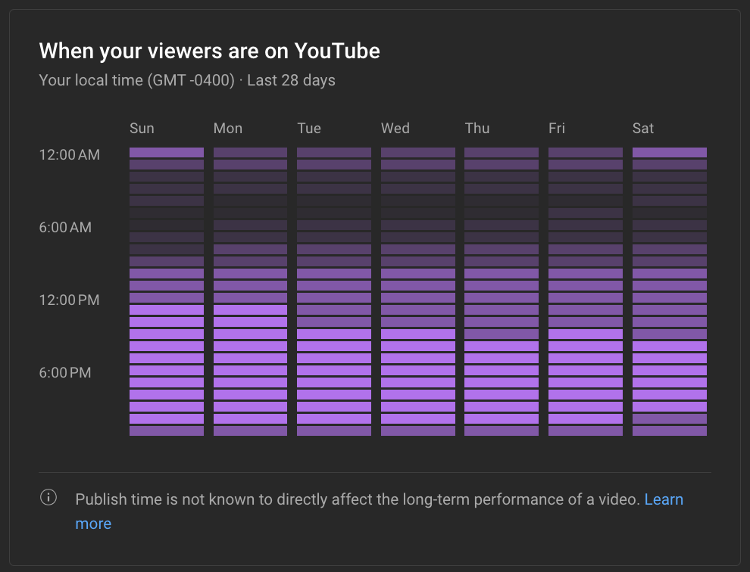
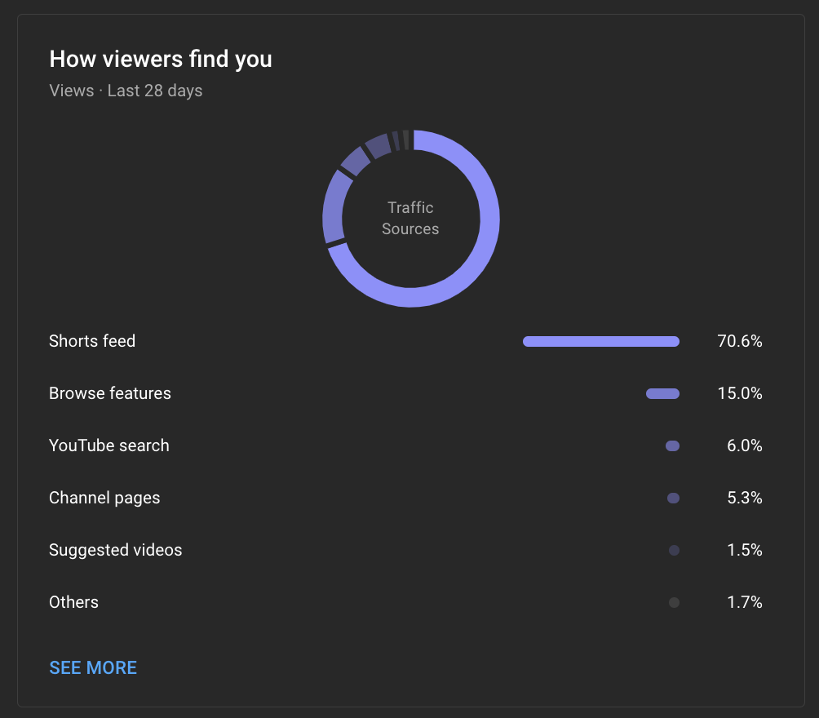
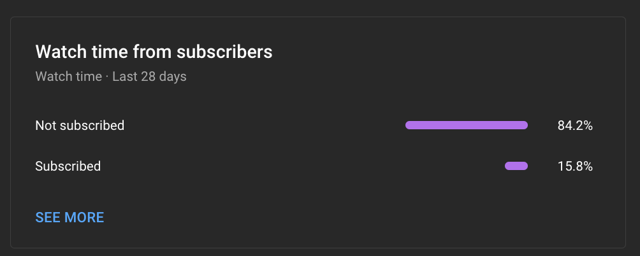
CN YouTube Analytics (Viewers)

Slide 8
Our biggest video got 22,000,000 million views in 2019... but of the 10
biggest videos we’ve
posted 5 have been
in the last 4 months
What this means
The channel is doing great! It’s ripe for growth
We just need to crack the code on what our next thing is

Slide 9
Talking Head
7 videos
391,000 Total Views
5.6% CTR
4,414 subscribers driven
5:17 avg view duration
30.5% average % viewed

Slide 10
Funky Friday Season 3
12 videos
1,053,000 Total Views
4.4% CTR
6,096 subscribers driven
11:19 avg view duration
20.5% average % viewed

Slide 11
C1N
11 videos
719,000 Total Views
4.7% CTR
5,559 subscribers driven
6:35 avg view duration
33% average % viewed

Slide 12
Shorts (2023)
129 videos
31,299,000 Total Views
6.1% CTR
68,930 subscribers driven
1:44 avg view duration
99.3% average % viewed

Slide 13
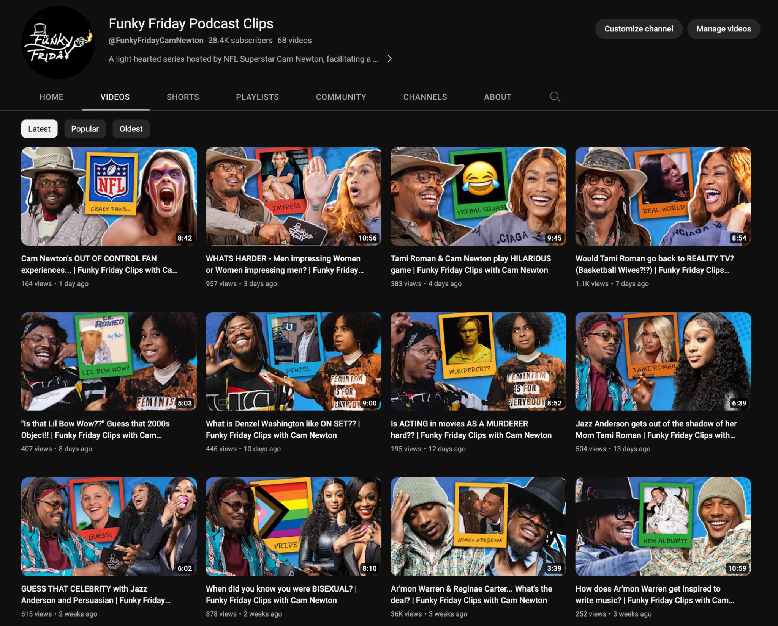

On April 7th 2023 we launched Funky Friday Clips as a place to put clips and shorts
Thoughts
Opens up lots of opportunity to title and thumbnail new content
Monetize the same video x times
Move FF pod here season 4

Slide 14
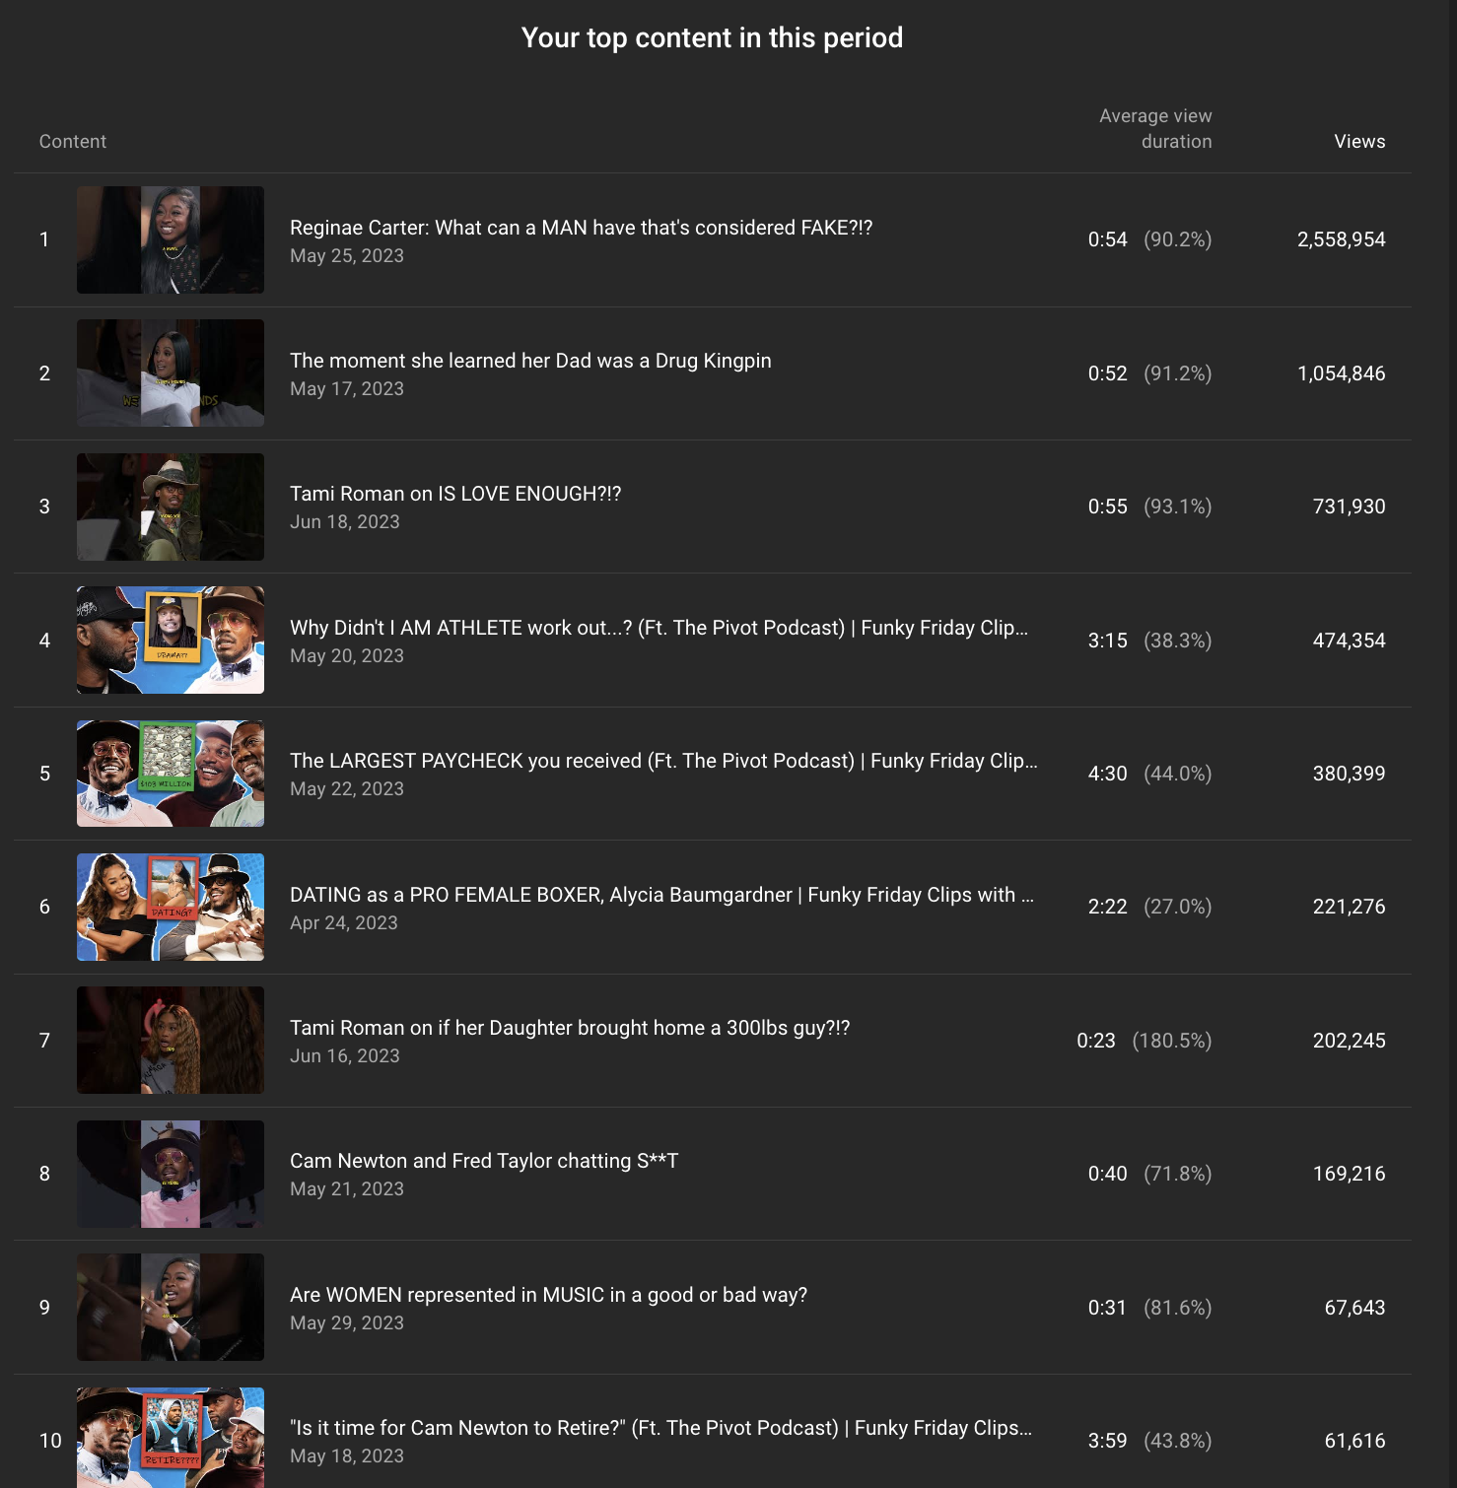
FF Clips
70 videos
34 Shorts
36 Videos
6,400,000 Total Views
7.8% CTR
28,000 subscribers driven
1:21 avg view duration
54% average % viewed
$3,255 generated

Slide 15
FF Clips
Move full pod here Season 4 Going to require “Launch” buildup
Title and Thumbnail CTR is very high about CN and YouTube average
Daily Posting Videos are scheduled weeks in advance in 1 sitting (2 hours title and thumbnailing per week)
Cost Editor cuts 3 clips and 3 shorts per episode (3 hours of editing / $150). Brendan and Kent cut more as needed/desirred
$ notes
Channel generates ~ $200- $250 a week

Slide 16
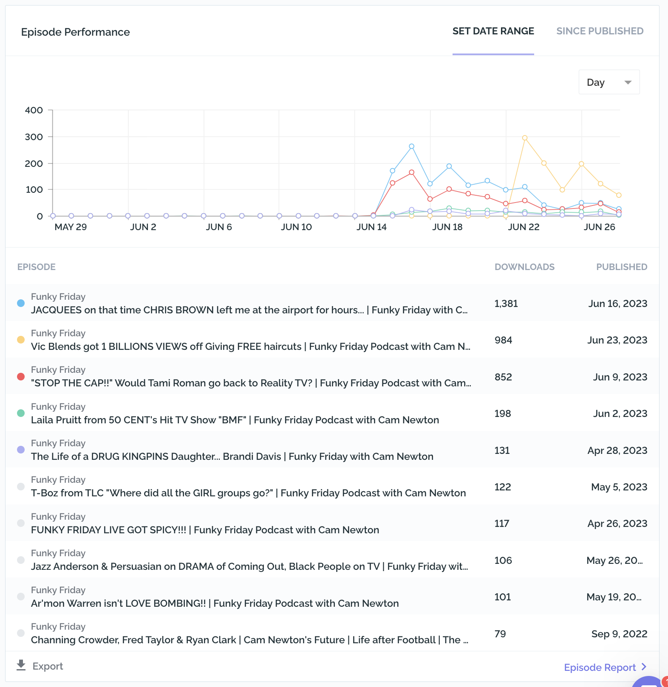
FF Audio check in
On Spotify video we received ~1000 views per pod
$0 income
0 promotion
Silver TRibe moved us to MEGAPHONE
Audio ONLY
PreRoll, Midroll, Post roll ads
0 promotion
Only recommendation is adding Apple, Spotify, podcast links + verbiage
Time
Jun 14 is when this data reset (14 days ago)

Slide 17


Meet Camerón
We have early access to ALOUD. AI dubbing of our episodes.
Currently dubbing into Spanish, Portuguese and Hindi
Takes a few days to reflect, doing 1 episode at a time
Relists video with new title, description, subtitles and dub
https://youtu.be/wb8R0ZEirUE
Tip
Tell the audience about the problem through a story, ideally a person.

Slide 18

The future of content...
Less but more...
Idea
Title
Thumbnail
Film

Slide 19


Sports “Game show”
Simple yet exciting “stakes” raising games
Always a collab - multiple characters
High energy
Football in hand content
Viral clips
Tip
If one example isn’t sufficient to help people understand the breadth of your idea, pick a couple of examples.

Slide 20
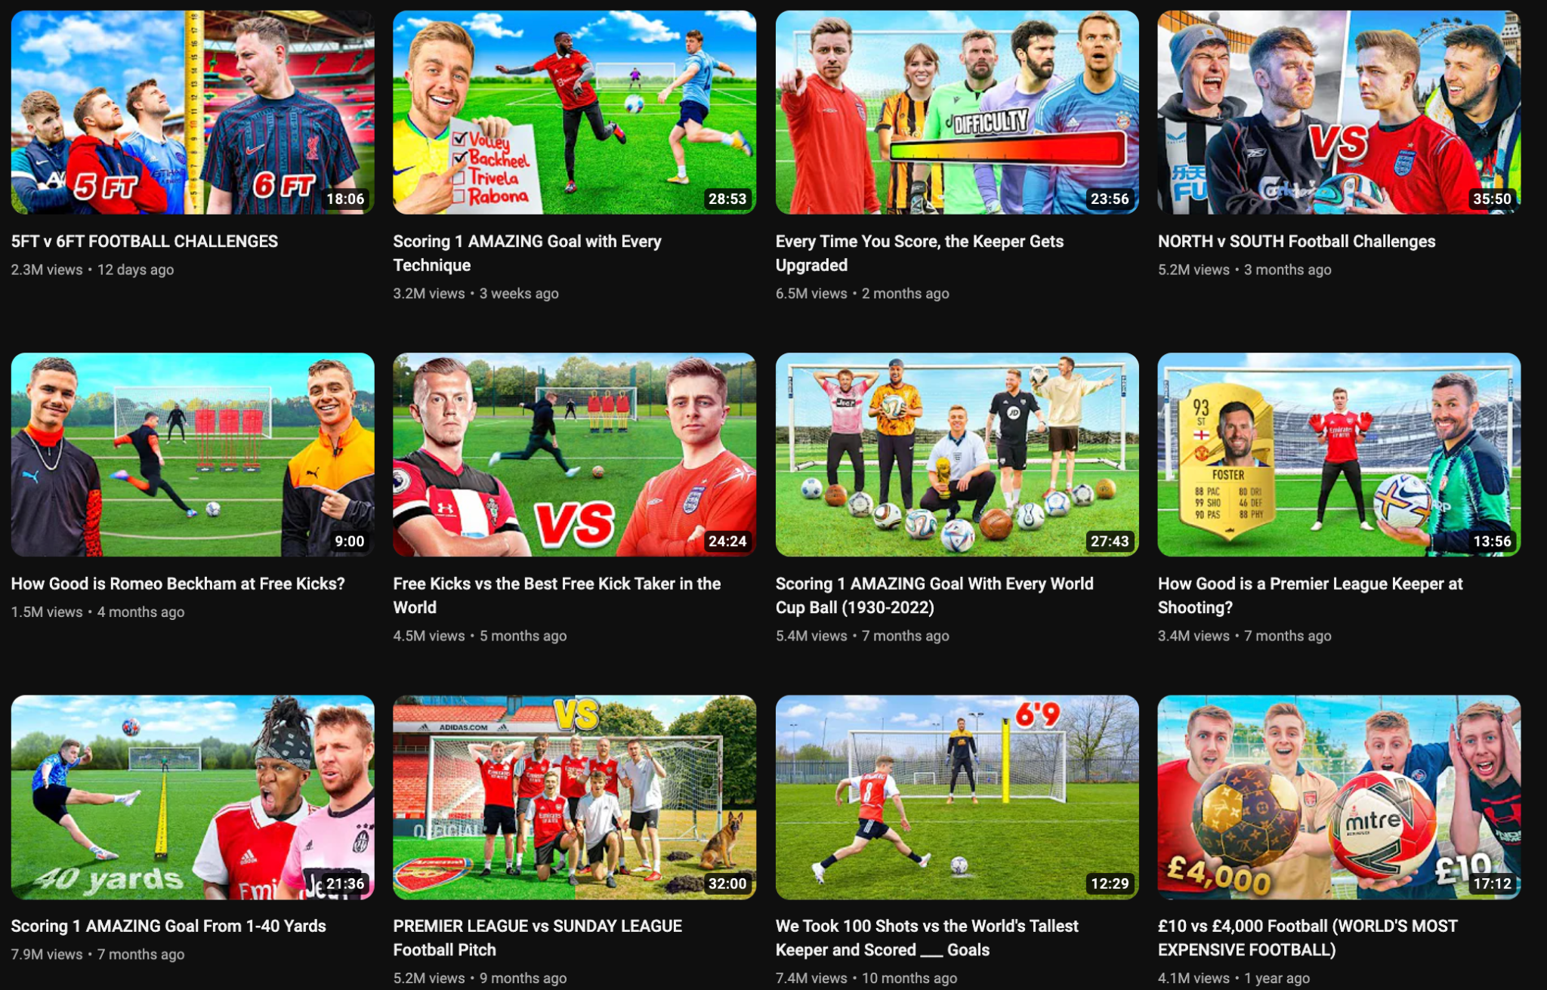
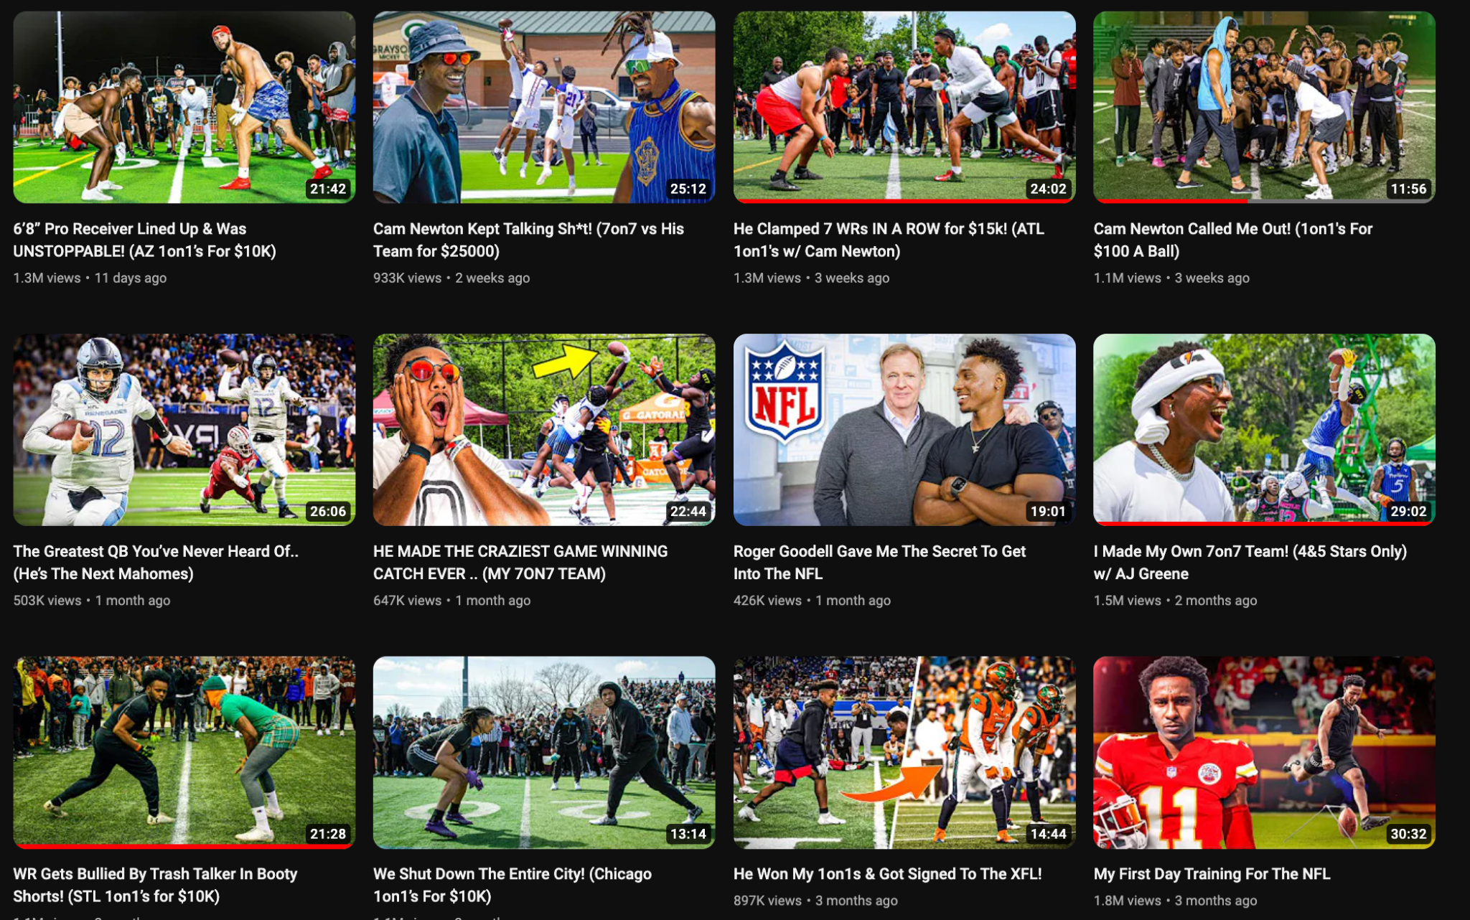
Thumbnails are super clear (Sky, goal, ball, action movement, expressive face)
Format is clear and constantly gets more interesting as “competition” unfolds

Slide 21
1v1 ladder with Cam as QB
1v1 to start. If offense wins, add a defender. Up to 5 or 6.
This is a take on Dreams minecraft manhunt
The challenge template is EXTREMELY tried and true
1v1 themed
1v1 NFL QB vs Youtube QB
1v1 NFL vs XFL
1v1 NFL vs NBA
Crossbar/goalpost QB challenge
Every touchdown the DB gets upgraded
5 year old DB to NFL?
Field goal kick challenge
Small to large football challenge
Routs, accuracy, kicking
Start with dollar store tiny football all the way to the largest football we can buy
Receiver challenge
First one to drop
Run same routs
Punter challenge
COuld we collab with Pat Mcafee?
Helium football challenge
Giant football “fear” Pong
Giant trash cans that look like solo cups
Each cup has a challenge on the bottom
Football golf
Either set holes or random objects as holes in a location
I.e. in DC. That tree over there, that door, that flag in the corner of the field
Home depot trash can with flag
Vs other NFL qb
🫡

Slide 22
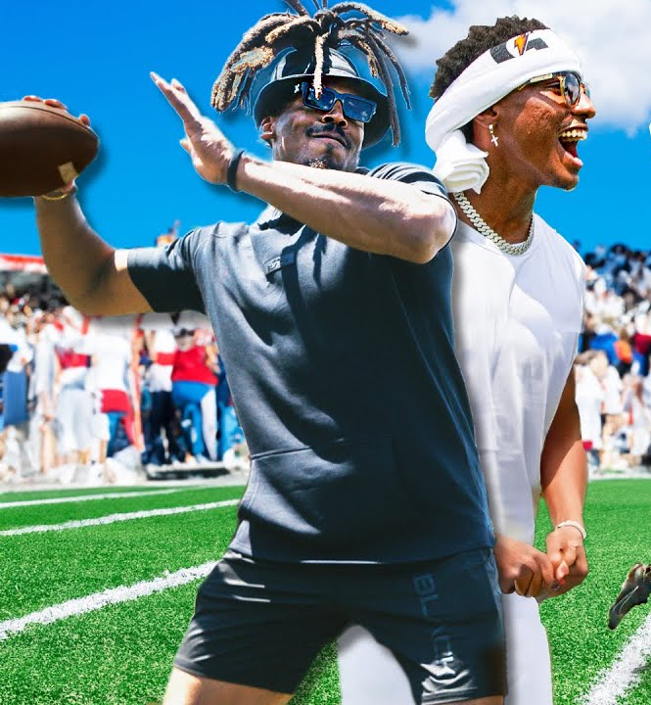
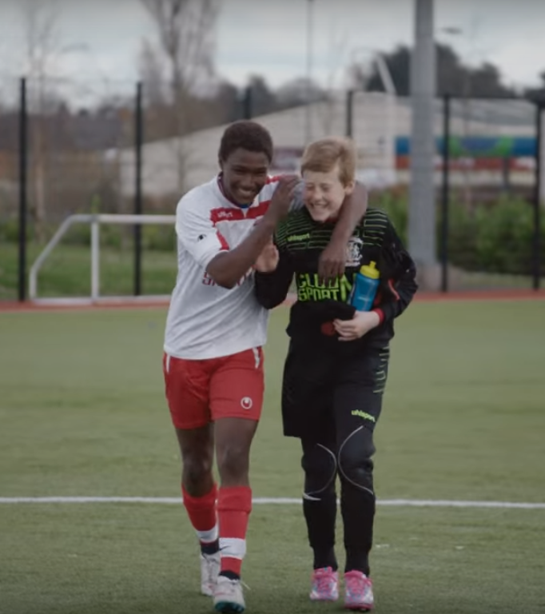
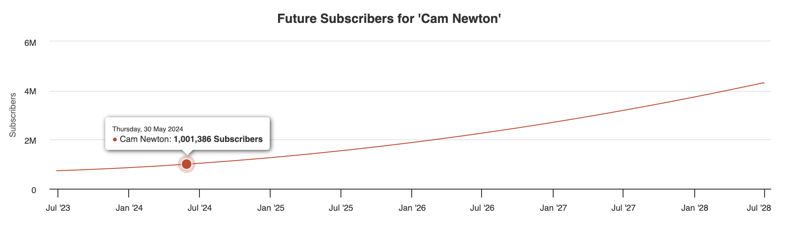
1 Million Subs 2023
Current projections get us there May 2024
Current 26k per month
Would need 45k per month
Tip
On videos where we asked for SUBS we grew about 2x videos where we didn’t
Small tricks won’t get us there... big ideas will

Slide 23

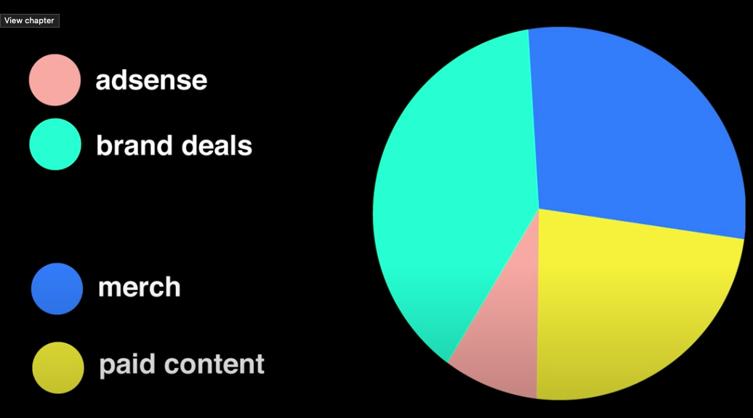
YouTube business
Tip
Relying on ADs as source of profit is wrong
Merch is low hanging fruit
Paid content may or may not be relevant
Brand deals...

Slide 24
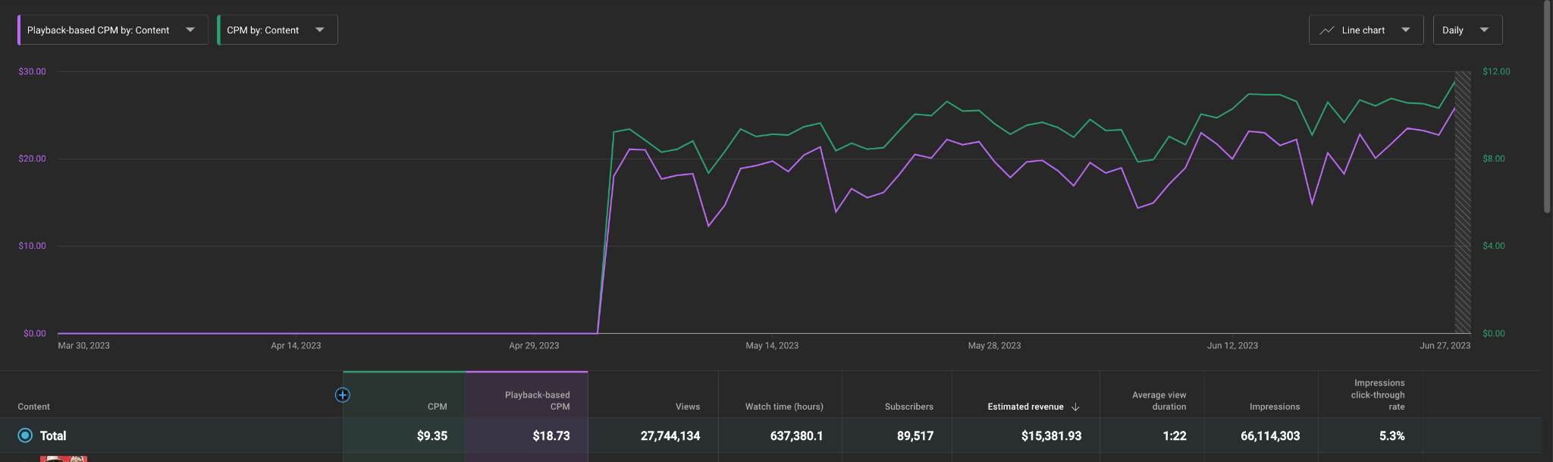
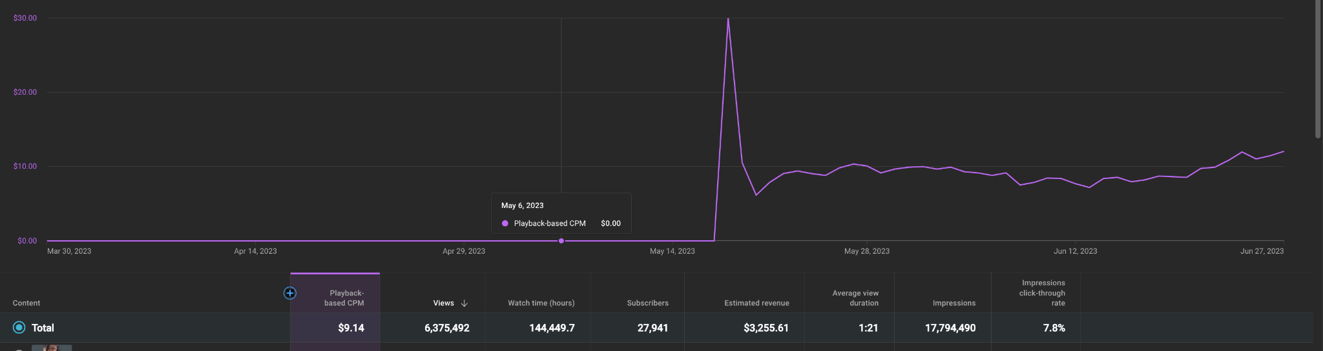
Ads
Adsense numbers are going up
RPM CN
Videos - $9.46 per 1000 views
Shorts - $0.10 per 1000 views
RPM FF
Video - $2.41 per 1000
Shorts - $0.09 per 1000
Estimate
$7,000 - $10,000 / Month (CN)
$1,000 - $2,000 / Month (FF)

Slide 25
Culture Genesis
Sells pre-roll ads to advertise who want to advertise on CN youtube
RPM
YT RPM - $9.46
CG RPM - $8.26
Total RPM - $17.72
Ads they sell Fanta, Ford, General Mills, Lionsgate, Marines, Tyson
May Slow start. They sold 161,000 impressions - $433.13

Slide 26

Merch can be sold directly under every video...
Merch sells best when worn by host and crew in EVERY video
Tip
Can be as simple or as complex as possible.
Treated as “BRAND” even if DTC to build identity

Slide 27


Running channels for others....
Most creators I do believe we could grow.
ATHLETES AND CONTENT CREATORS
welcome...
But consider...
There is no reliable money to be made in Ads
Average “split” is 80:20 or 70:30 on ad revenue
Small numbers become smaller
$ is in the MERCH
$ is in the BRAND DEALS
We don’t currently sell brand deals
We outsource
We don’t have practice
Selling
Filming
Reading
Approving

Slide 28
A solution
We host the “Shows”
Pay creators to “host” talent fee
We control the content distribution + monetization
Sports
Fashion
Business
Drama
Music
One channel, or multiple...
Think “Boardroom” by Kevin Durant
Sneakers, Music, Weed, Food etc
This plan requires clarity with Hosts. We encourage them to build own platform and grow with us, grow with us. But we own this content, top to bottom. Channel builder/owner roles most often end in disaster, in the end the content suffers (Liquid Light). Pay the creator a fair fee, we monetize the content on our end.

Slide 29
Kent Update
I believe I can lead this team to large success on youtube, but I don't think that’s in the editing bay...
CTR
I’ve spent 3-4 days on a edit that achieves less views than a thumbnail I spent an extra 1-2 hours on
Multiple channels
If we grow the business, I can take on more clips, shorts, channels and strategy
Mental health
The edits are taking me away from where my passion is. Im stretched extremely thin

Slide 30

A strong focus on ideas can allow us to achieve greater success. We have the
team, we just need
focus
...
I really do not think radical change is needed to find success. Just focus in certain areas to grow profit, audience and quality.

